Slide 1
Process Health Data with Time

Slide 2
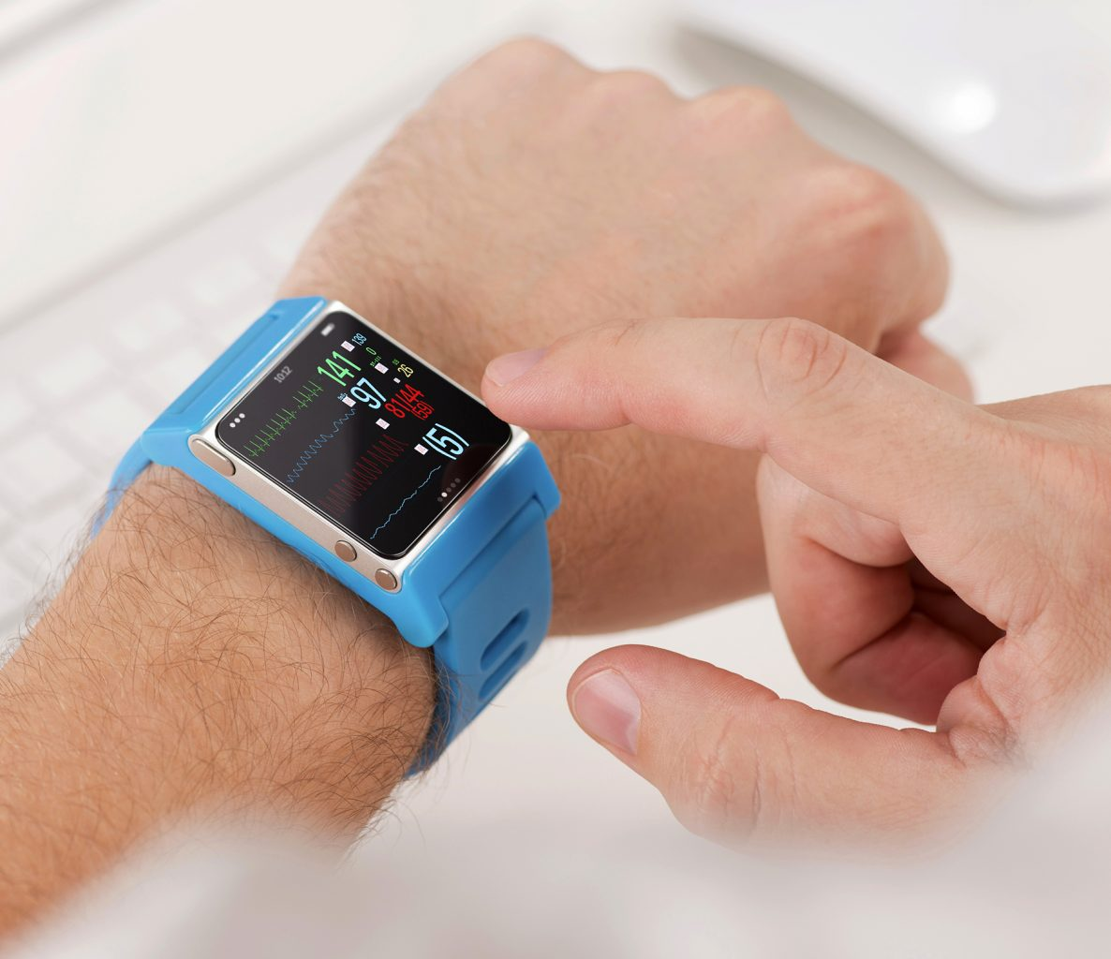
1,Why?
What is health data?
devices attract data everyday
Why we need to analyze data with time?
life is dynamic, not static, so do we
reflect our health condition, have a sense of achievement
How to simplify the process with R?
find the common ground between data
no more coding, easy to get started

Slide 3
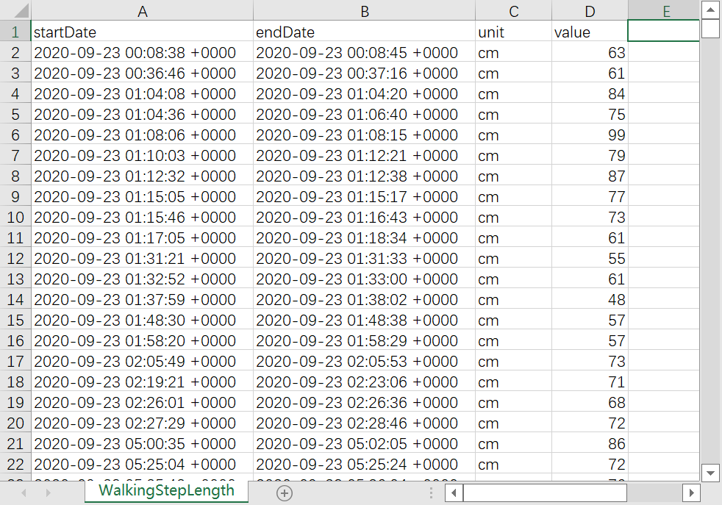

Time?
Can be a specific time point
Or, a time period with start and end
What we want is:
Input only time data and your demand
Output related graphs and statistical results

Slide 4
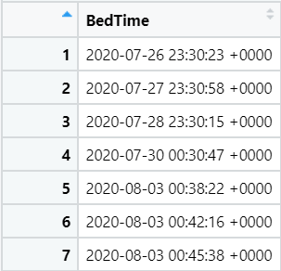
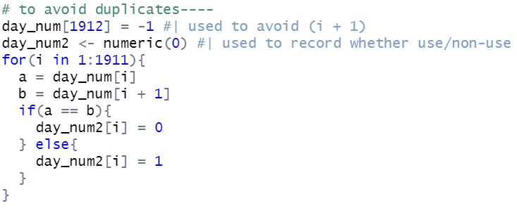
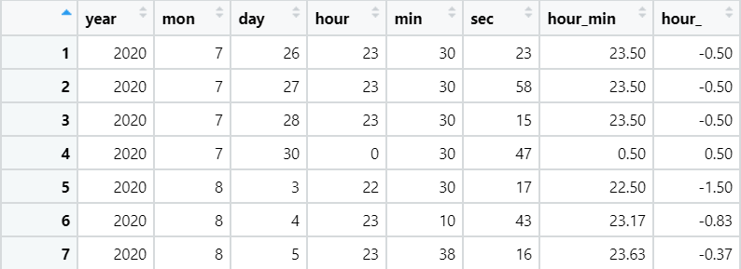
2,Time core code(point)
If we have duplicated time data in the same day
We can do simple comparisons to get useful info

Slide 5
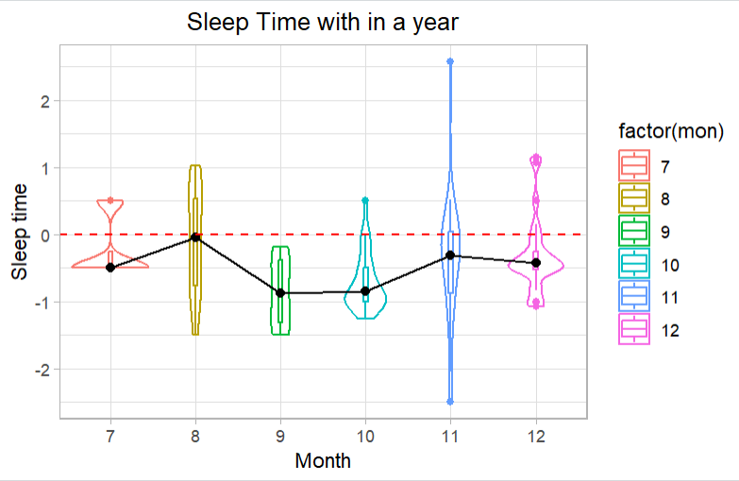
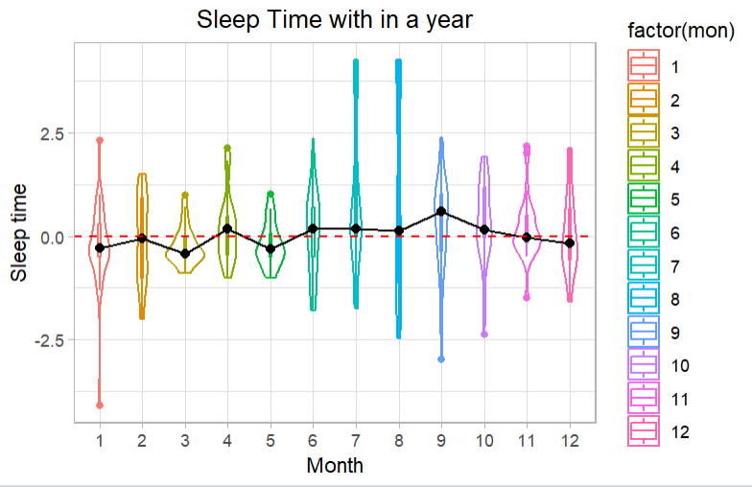
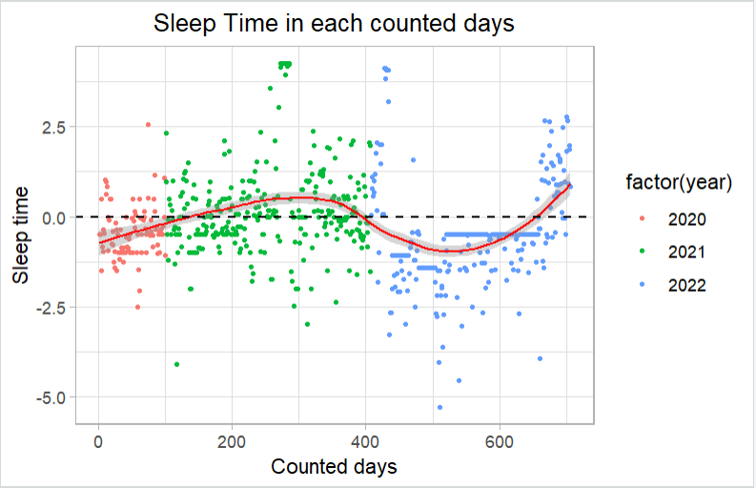
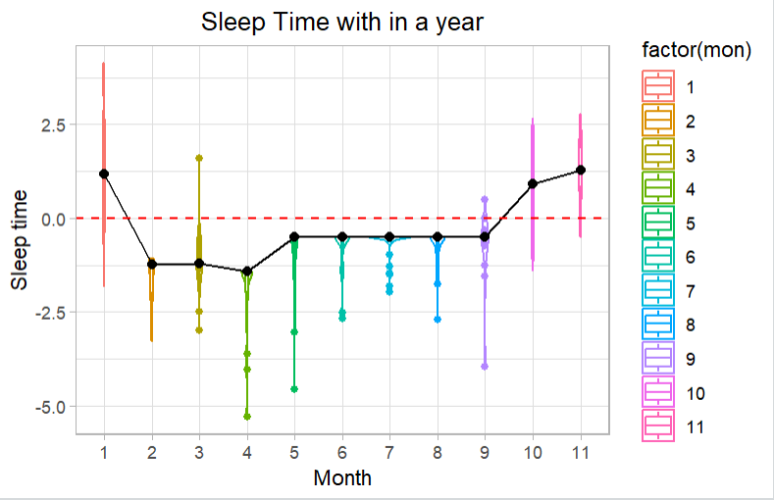
Continue…
2020
First use sleeptime() to get a dataframe
Then use overall(df) to see the trend
Finally use specific(df, num) to see each specific year
2021
2022
Overall

Slide 6
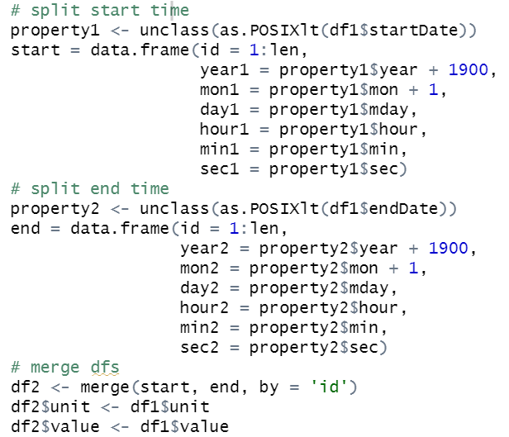
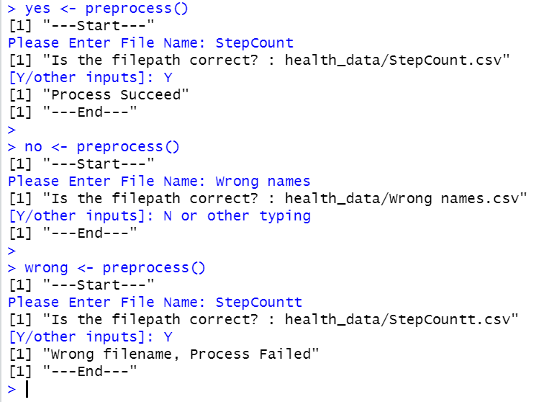
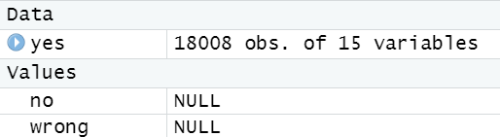
3,Time core code(period)
How to process time data?
df <- preprocess()

Slide 7
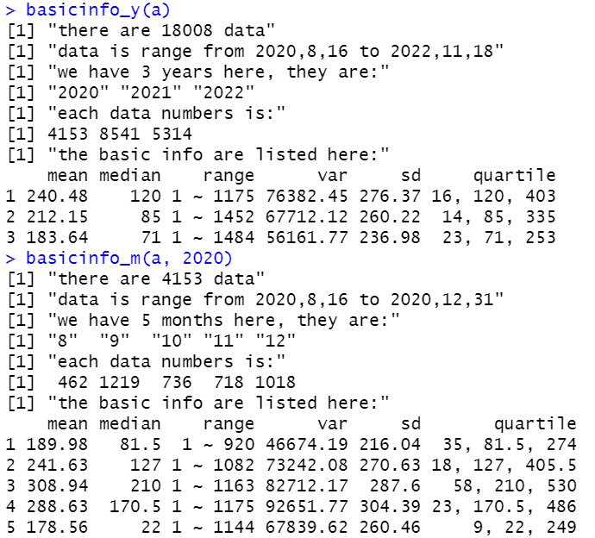
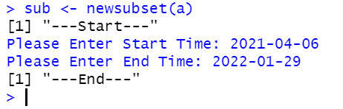
Continue…
Basic information:
-> using basicinfo_y(df) and basicinfo_m(df)
-> better than just summary()
Subset our data:
-> using sub <- newsubset(df)
-> you need to type in start time and end time (yyyy-mm-dd)

Slide 8
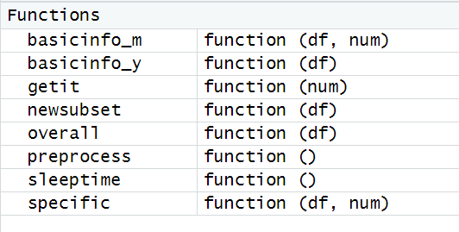
4,Practical time!
What we have learnt before:
-> Descriptive graphs
-> Hypothesis tests (z/f/t test)
-> Regression and Correlation
Now it’s time to use health data to create something new!
With our functions above

Slide 9
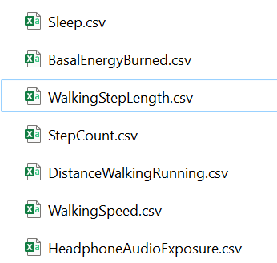
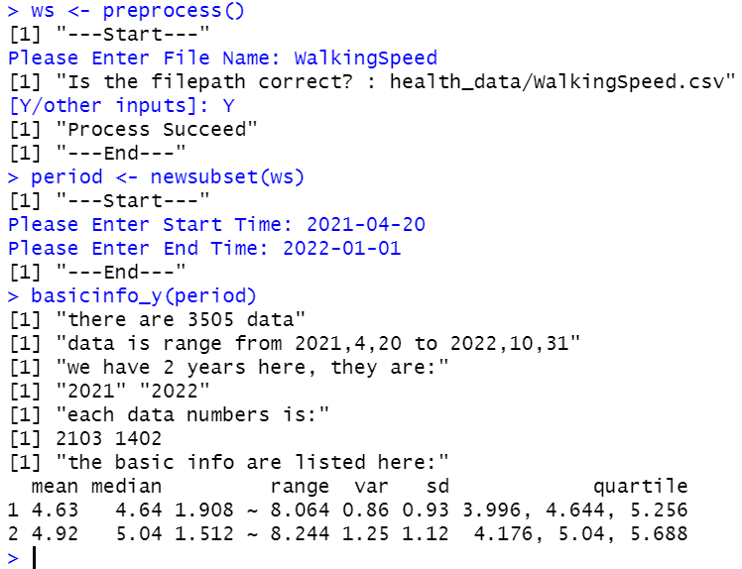
Examples:
If you are interested in WalkingSpeed from 2021-04-20 to 2022-01-01
-> You can just do like this to get a overview:
-> Then you get not only statistical info
but also a subset of interest
What about graphs?

Slide 10
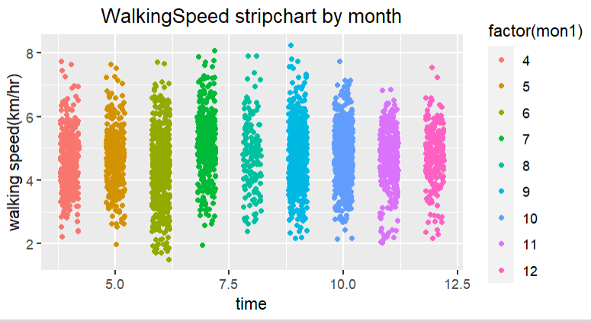
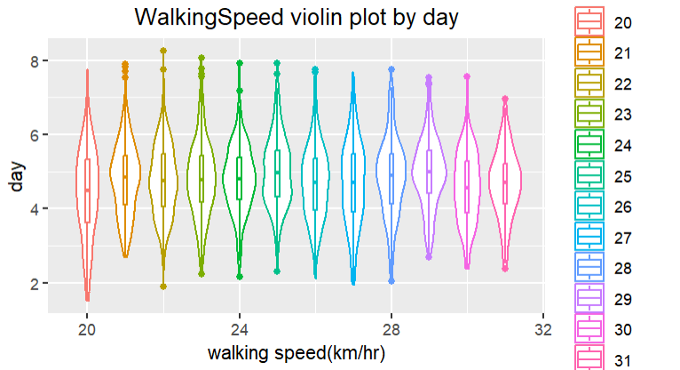
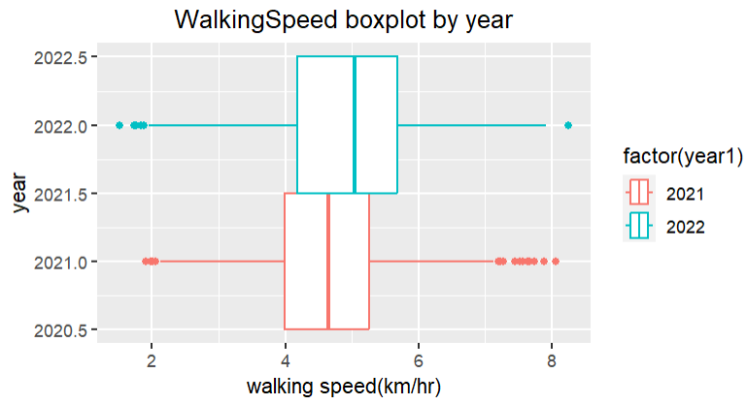
Just ggplot2
Boxplot
Stripchart
Violin plot

Slide 11
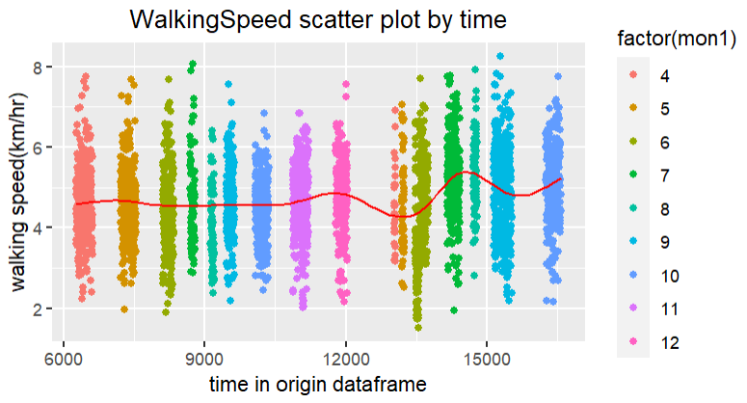
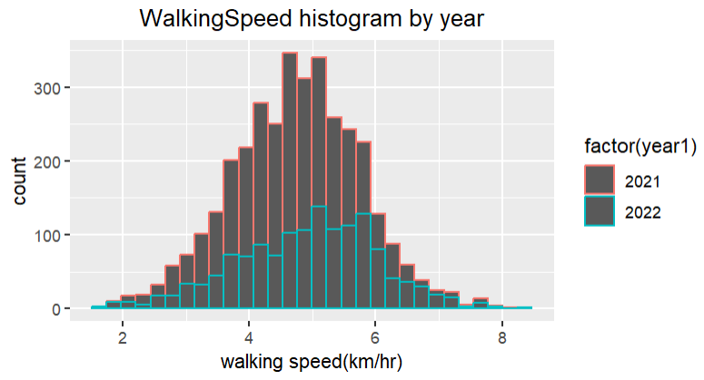
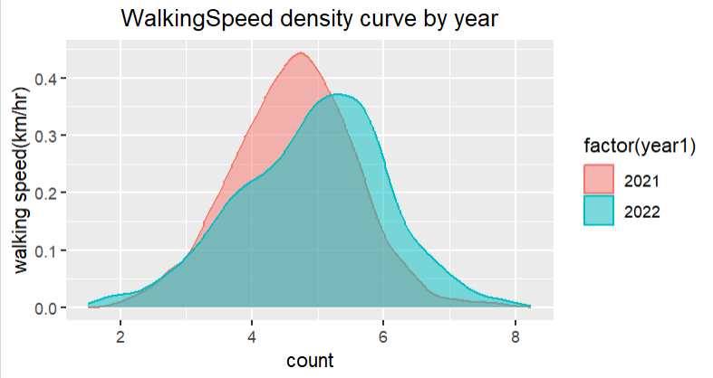
More…
Histogram
Density curve
Scatter plot

Slide 12
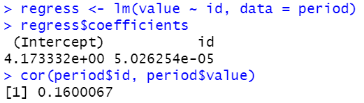
Hypothesis tests Regression and Correlation
Can also easily done by previous subset of interest
number is large: z test(sd given), small: t test(sd not given)
If we guess that during this period, the mean value of walking speed is more than 4.7, with alpha 0.05
p value is 0.0026, so reject H0, mean > 4.7
And the relationship between time and walking speed is:
almost a horizontal line
weak association

Slide 13
5,Summary
Shortcomings:
1, More try-catch should be used to reduce errors
2, Still lack of simflexibility and user choices
Fulfill the goal of plify process of health data
Data with similar type also can be processed
Data can be interesting with R and statistics

